Slide 1
Fast Binary Counters and Compressors Generated by Sorting Network
Aakarsh Dev MT2021501
Animesh Kumar Tiwari MT2021505
Under the guidance of Dr. Madhav Rao

Slide 2
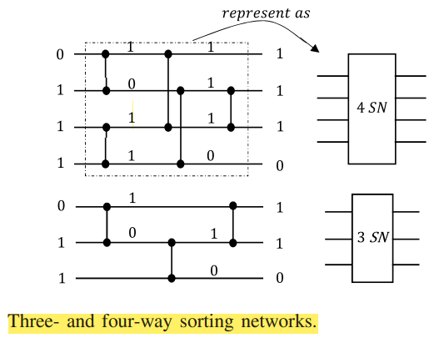
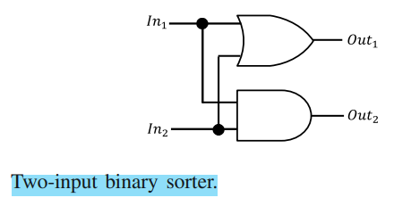
7 BIT SORTER DESIGN
It takes 7 bits as inputs and sorts them into 1s and 0s.
Written the code for it and tested on Vivado.
The single vertical lines are 2 bit binary sorter which will be used to make bigger sorter.

Slide 3
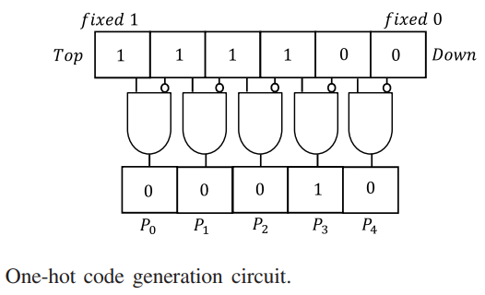
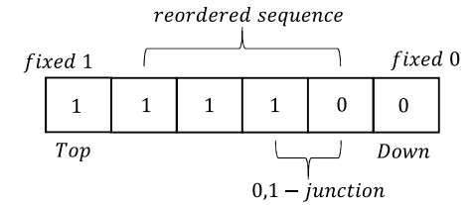
ONE HOT CODE GENERATION
We will generate this code sequence for both 4 bit sorter and 3 bit sorter.
Output of 4 bit sorter one hot code sequence will be represented by P0, P1 etc.
Output of 3 bit sorter one hot code sequence will be represented by Q0, Q1 etc.
This reordered sequence is
called H for 4 bit sorter and I
for 3 bit sorter.

Slide 4



7-3 COUNTER DESIGN
This counter will take 7 bits as input and produce 3 output bits S, C1 and C2.
The equations for each sum and carry bits will be :
C2

Slide 5
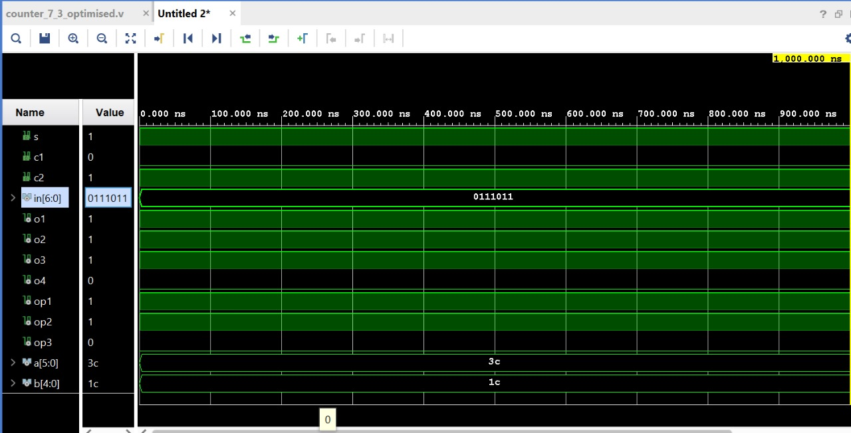
RESULTS OF 7-3 COUNTER
Summation of 0+1+1+1+0+1+1
is 101.

Slide 6
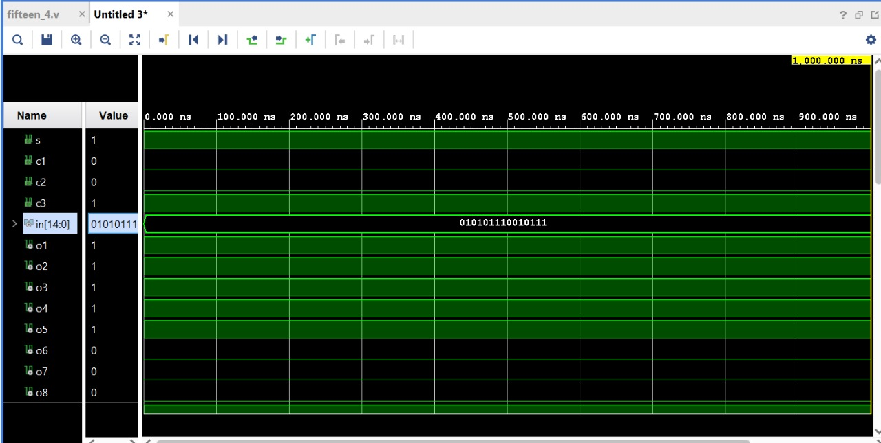
RESULTS OF 15-4 COUNTER

Slide 7
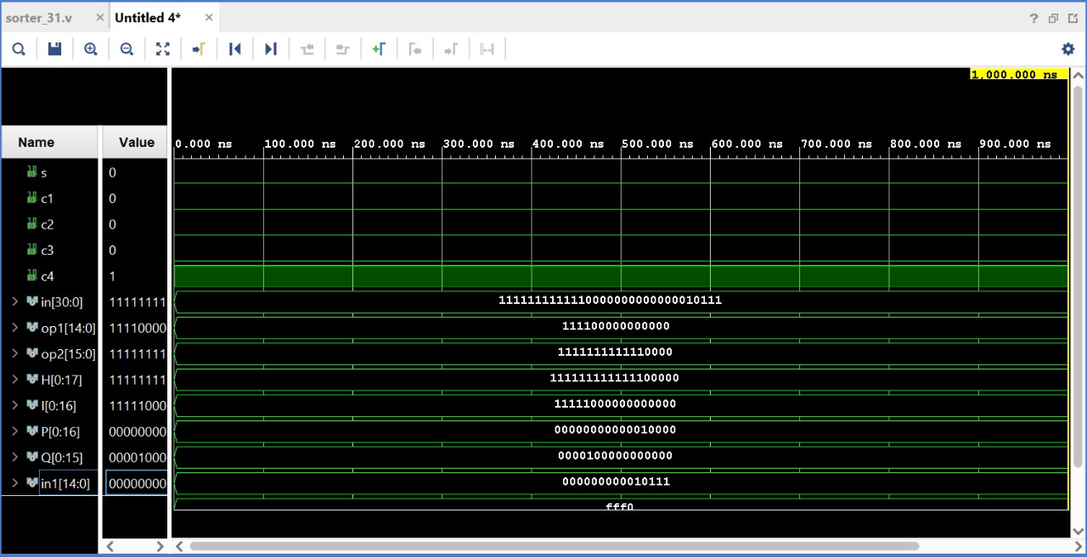
RESULTS OF 31-5 COUNTER

Slide 8
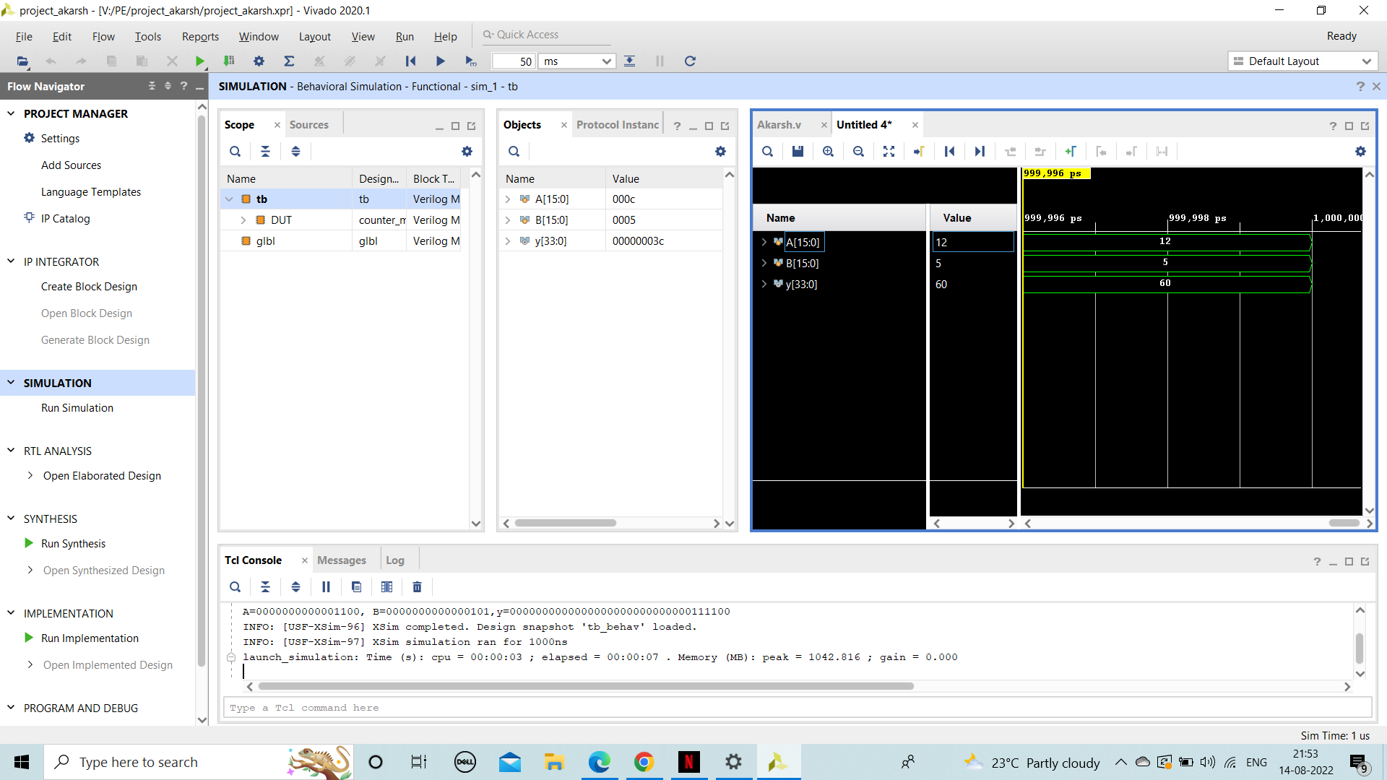
IMPLEMENTATION OF 16 BIT MULTIPLIER

Slide 9
COMPARISON OF IMPLEMENTED DESIGNS
DESIGN | AREA (μm²) | GATES | TIMING (ps) | POWER (uW)
7-3 COUNTER | 81.5 | 89 | 865 | 5.8
15-4 COUNTER | 194.2 | 121 | 1134 | 7.5
31-5 COUNTER | 365.5 | 677 | 2399 | 10.6
8 BIT MULTIPLIER | 1144.8 | 255 | 3874 | 10.1
16 BIT MULTIPLIER | 4356.7 | 1634 | 7562 | 55.9

Slide 10
COMPARISON OF IMPLEMENTED DESIGNS
DESIGN | AREA (μm²) | GATES | TIMING (ps) | POWER (uW)
CUBE MULTIPLIER | 7942.1 | 2396 | 8930 | 82.1
QUAD MULTIPLIER | 13945.7 | 5811 | 15991 | 113.9

Slide 11
IMAGE BLENDING USING 16 BIT MULTIPLIER
Image Blending :
we know already a bit of Pixel operators. An interesting dyadic (two-input) operator is the linear blend operator:
g(x)=(1−α)f0(x)+αf1(x)
By varying α from 0→1 this operator can be used to perform a temporal cross-dissolve between two images or videos.

Slide 12
